Slide 1

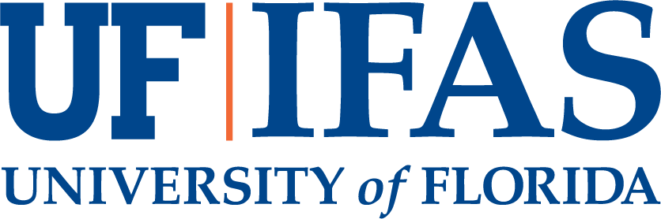
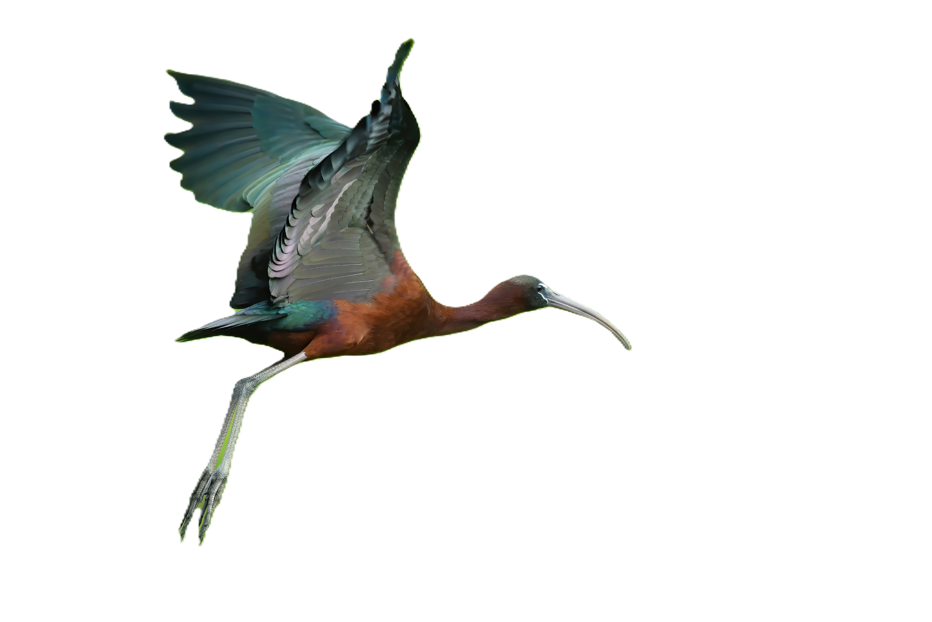
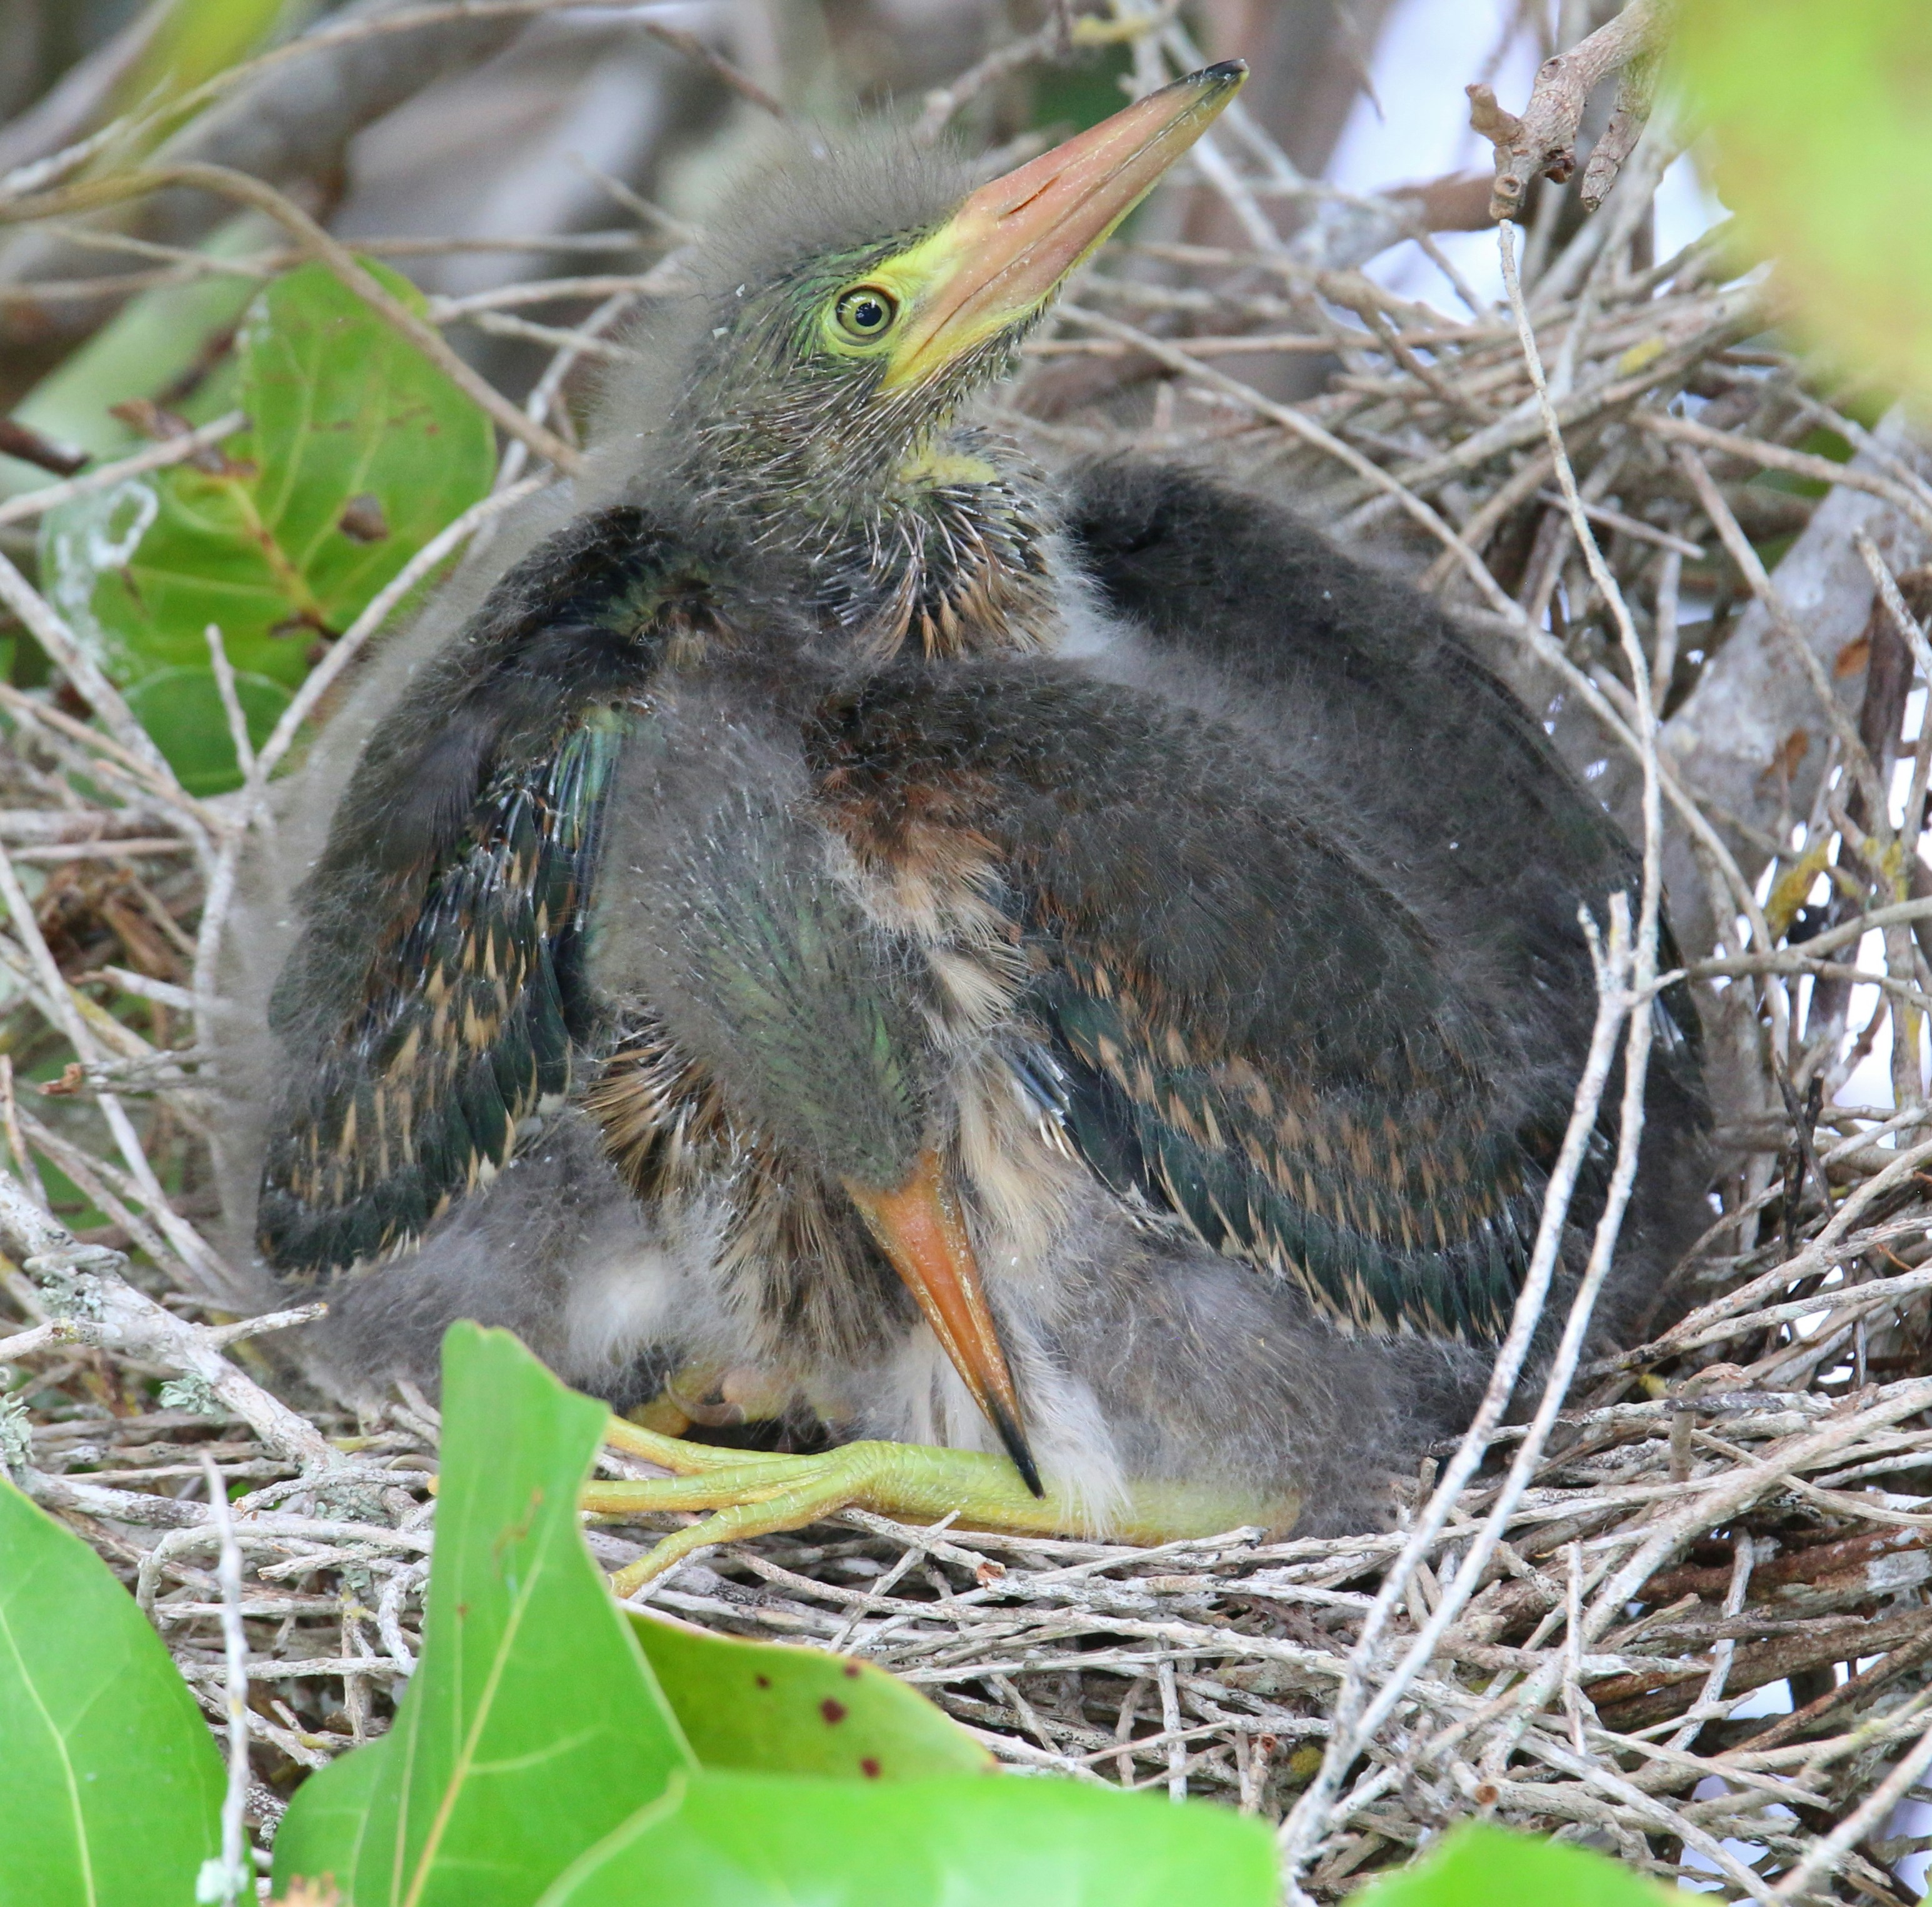
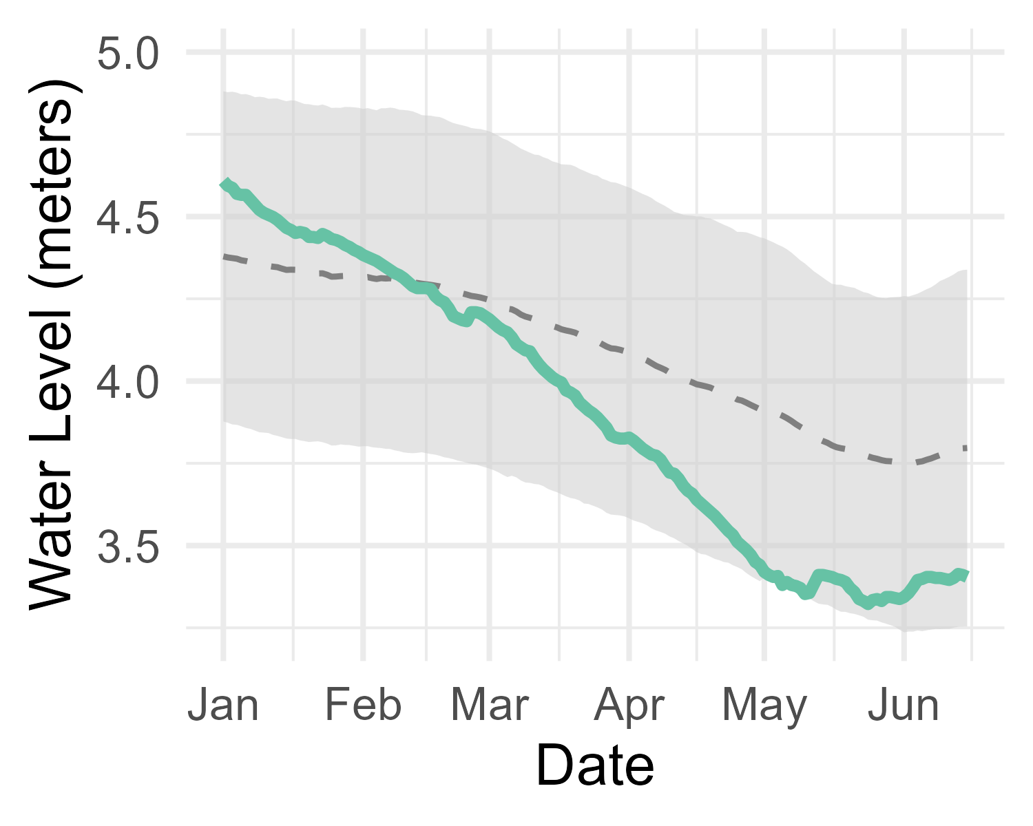
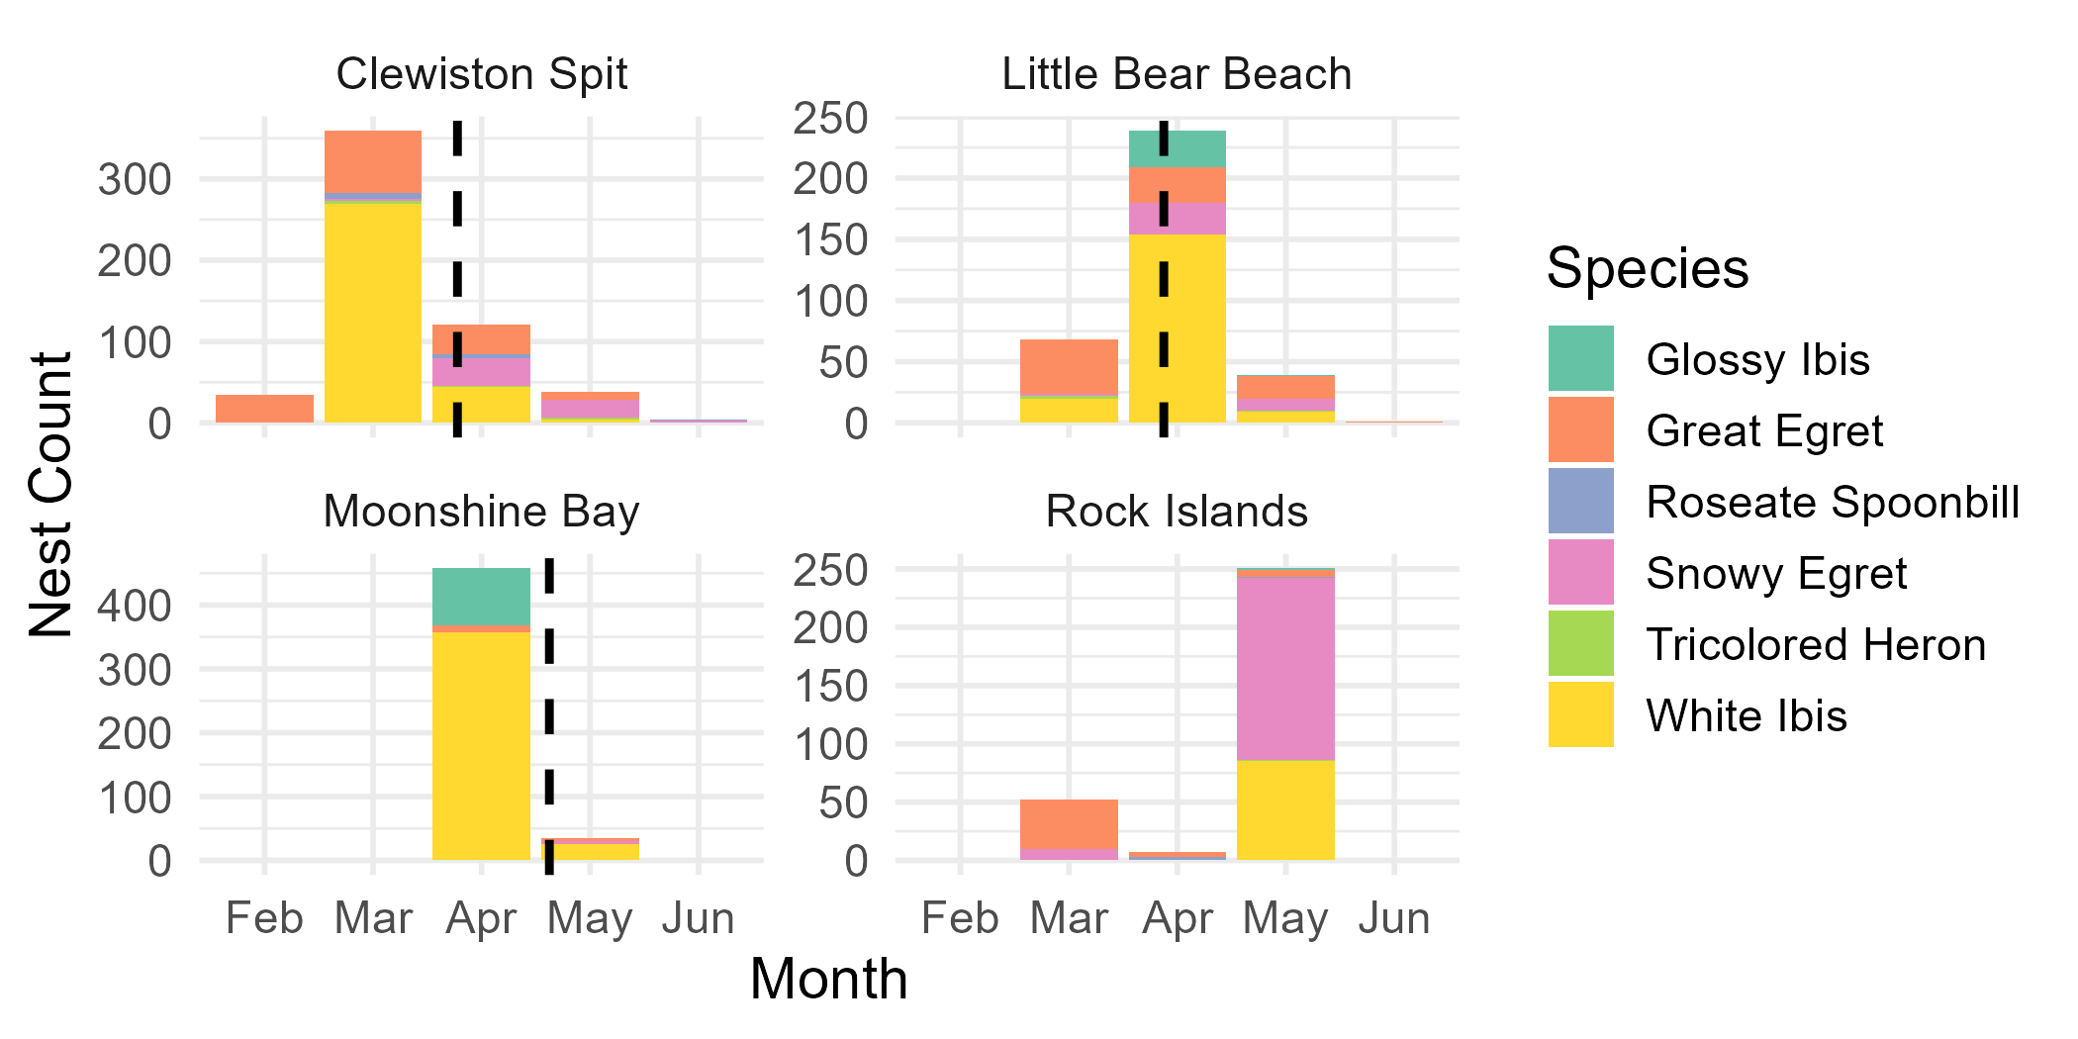
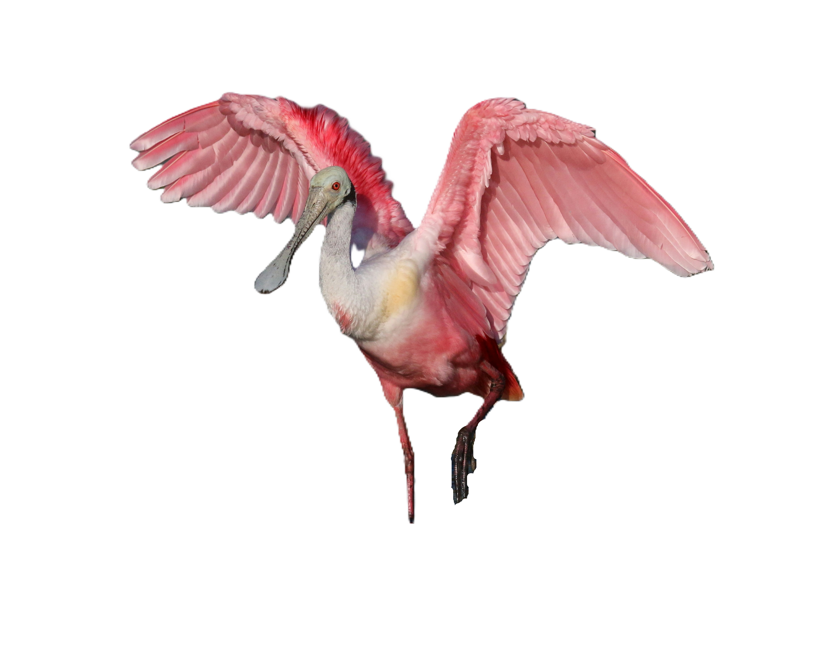
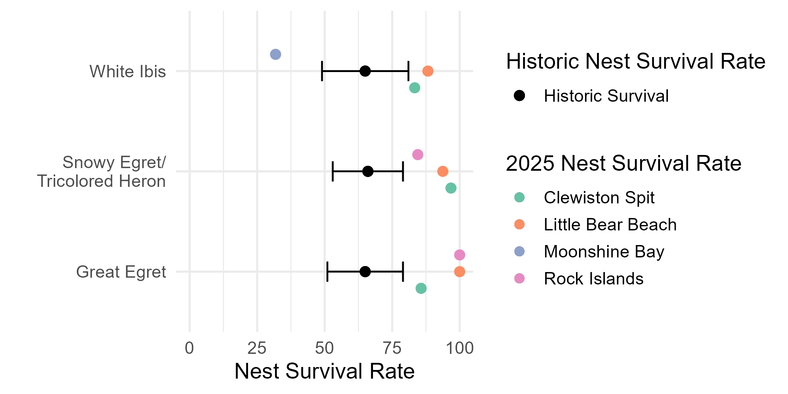
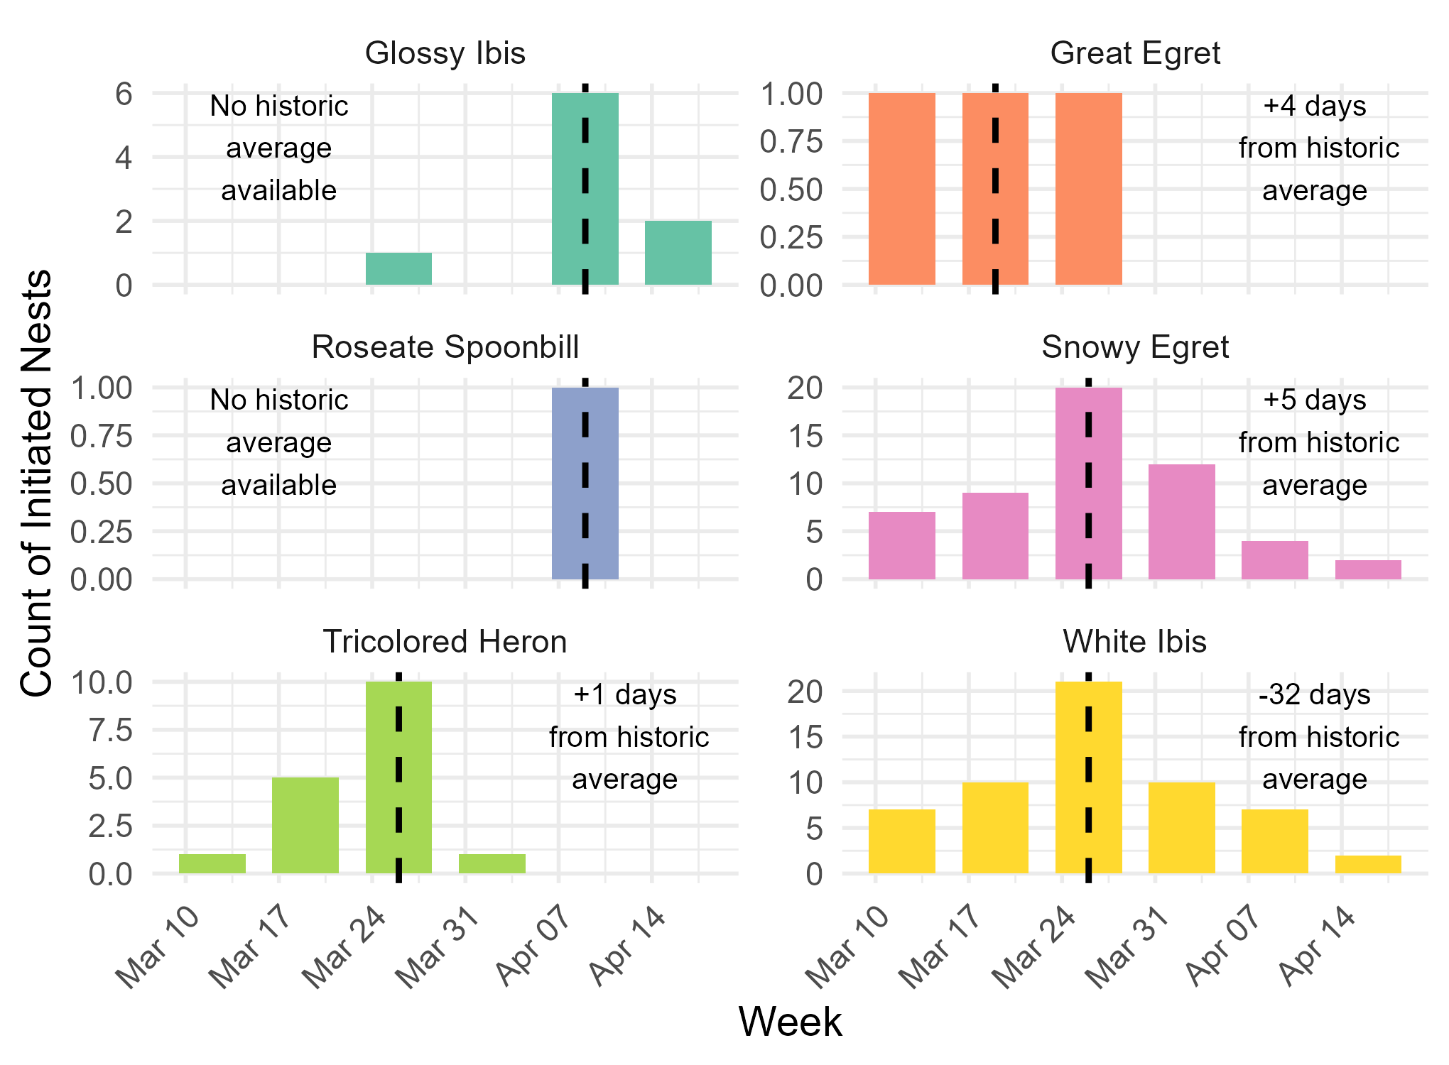
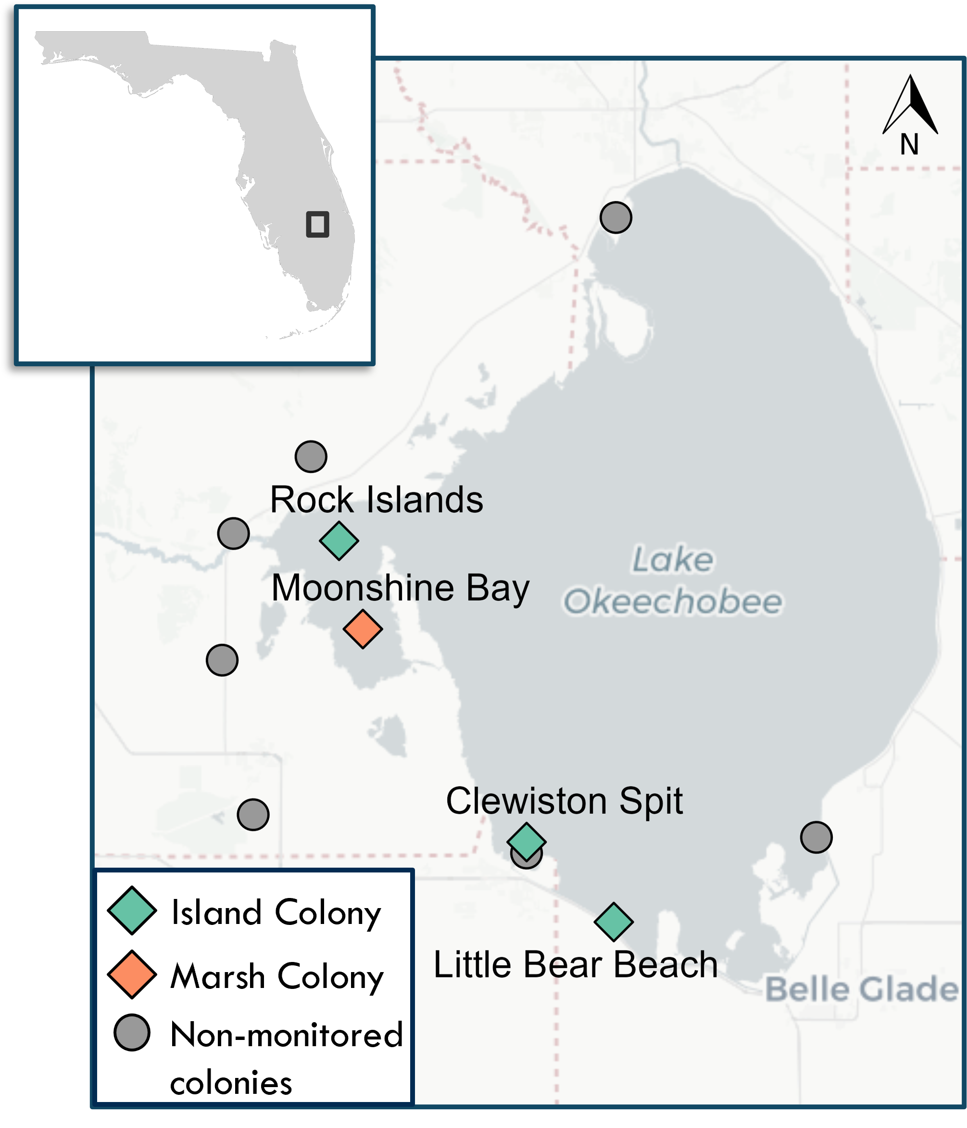
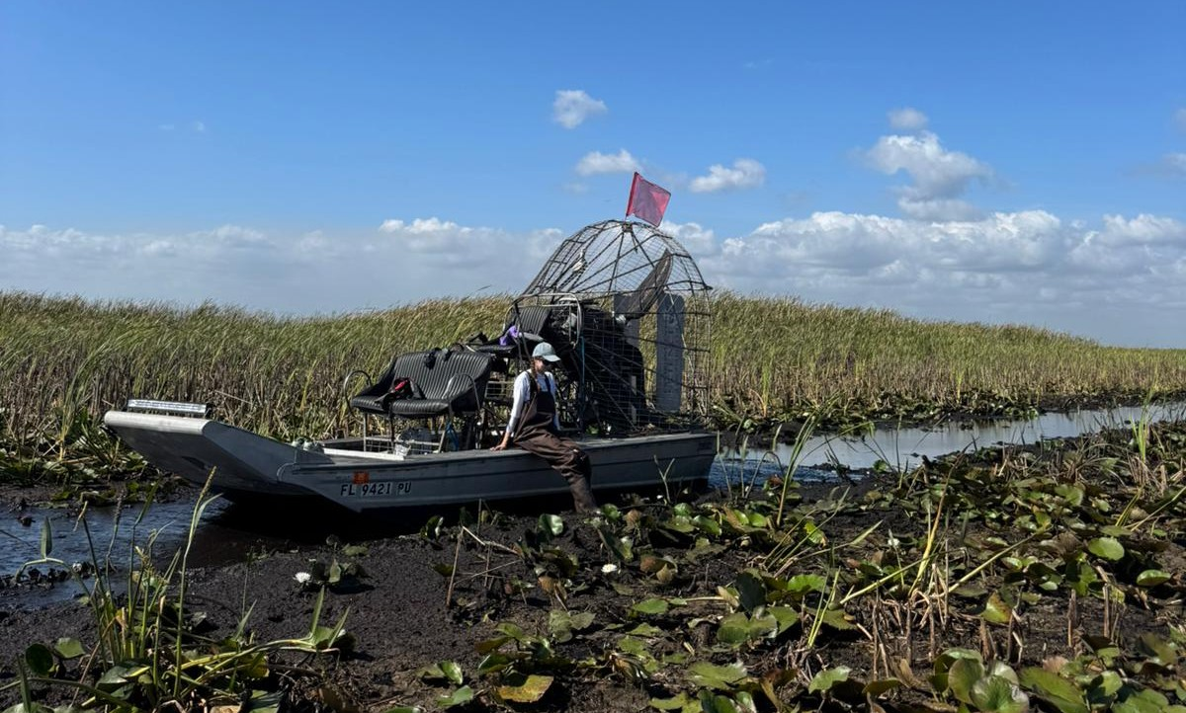
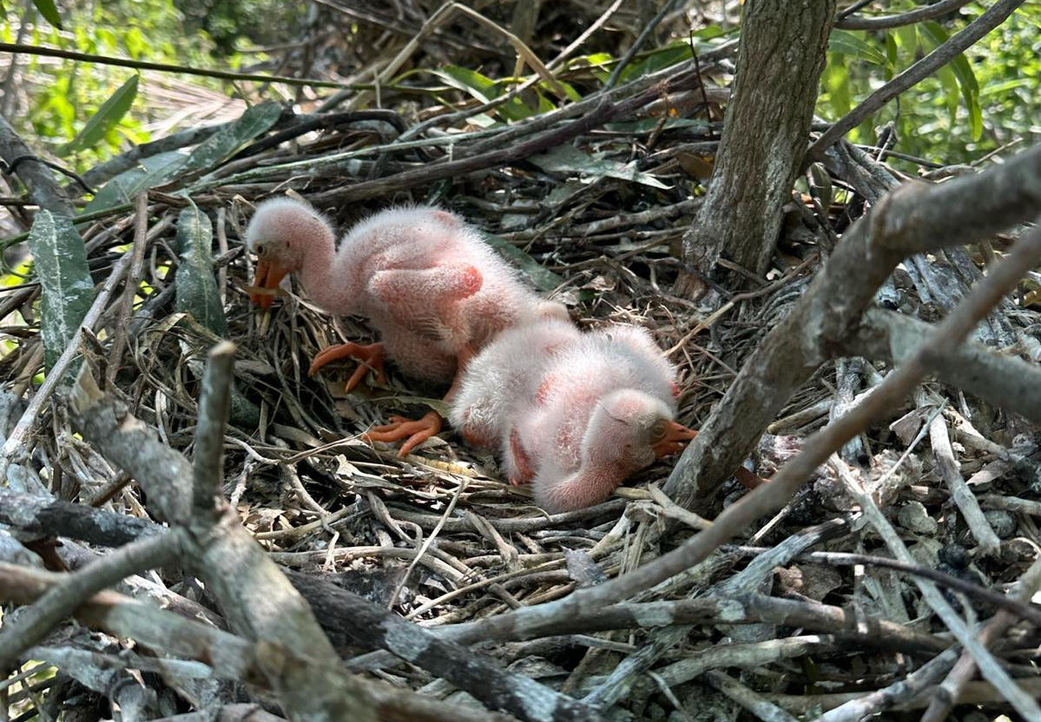
Assessing Nest Productivity and Success of Wading Bird Breeding Colonies in Lake Okeechobee
Janina E. Mulling, Brittany M. Mason, Mario Zuliani, C. Analise Fussell Persaud, Corey T. Callaghan
Department of Wildlife Ecology and Conservation, Fort Lauderdale Research and Education Center, University of Florida
Background
Results
Wading birds are critical indicators of ecosystem health as their ecological position makes them sensitive to changes in environmental conditions.
Monitoring wading bird nest productivity (i.e., the number of eggs produced from one breeding attempt) and success (i.e., the percentage of nests that have successfully fledged at
least one individual) helps track breeding populations and habitat restoration efforts in the Everglades and Lake Okeechobee.
Fig. 2. Nests observed on aerial surveys with historic average peak nesting month (dashed line). No historic data for Rock Islands is available.
Fig. 3. Green line is water level in 2025 from Jan 1 to June 15. Dashed line is historic average, and gray shading is the standard deviation from historic average.
Research Question
What was the wading bird nest productivity and success in 2025 related to previous years?
Methods
Ground surveys and monthly aerial surveys to locate active breeding colonies
We monitored 231 nests at 4 colonies
Weekly nest checks: nest condition, species, stage of bird
Fig. 4. Historic nest survival rates are an average obtained from the Wading Bird Reports since 2023. The error bar represents the standard error of estimates.
Fig. 5. Nest initiation is 21 days (or 25 for Great Egret) minus hatchling date. The vertical dashed line is the mean nest initiation date in 2025 and the text denotes if this is earlier or later than average.
Implications
The higher than average water level recession rate may have affected nest initiation dates because nests in colonies with low water levels are more accessible to predators and farther from forage sites.
Ecological impact of water management application must be considered to avoid undermining restoration and conservation efforts.
Fig. 1. 2025 nesting colonies on Lake Okeechobee.

